Slide 1

Orientation day
NEPTUN USER GUIDE FOR STUDENTS
University of Nyíregyháza
2024.09.03.

Slide 2
THE DATE OF PERSONAL ENROLMENT IS FOR ALL THOSE ENROLLED IN BACHELOR STUDIES OR MASTER STUDIES:
During September, at a pre-arranged time
LOCATION:
Student Service Centre
Building A , Groundfloor, Room 28 (Sóstói út 31/B)
Katalin Fejérvári
fejervari.katalin@nye.hu

Slide 3
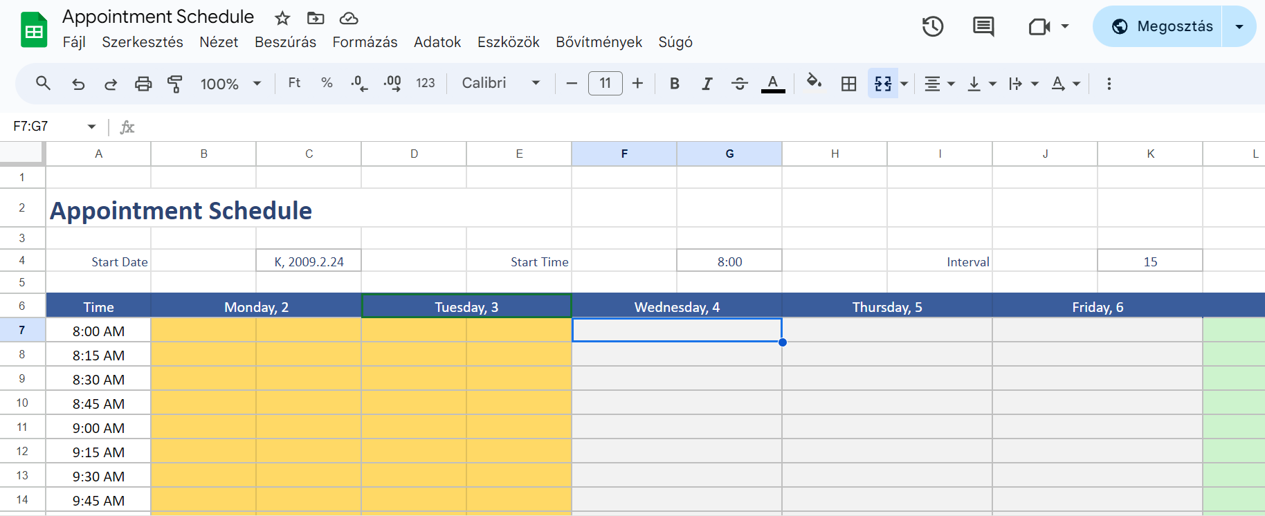
Book an appointment!

Slide 4
FOR PERSONAL ENROLMENT, PLEASE BRING THE FOLLOWING:
a printed, completed and signed enrolment sheet
your passport and a photocopy
Language exam certificate (original document, and a certified translation in English or Hungarian) - if available
Training contract in 4 copies (3 in English and 1 in Hungarian)
Medical certificate (original document, and a certified translation in English or Hungarian)
1 ID picture (3.5 x 4.5 cm) with your name and the date of birth on the back
the original documents taken into account in the decision of acceptance:
o in Bachelor studies, the high school diploma(s) in original language and in English;
o in Master studies, the higher education degree certificate(s) in original language and in English;
and photocopies of the original high school diploma, the degree certificate(s).
Original copy of the Final Letter of Admission and and a photocopy

Slide 5
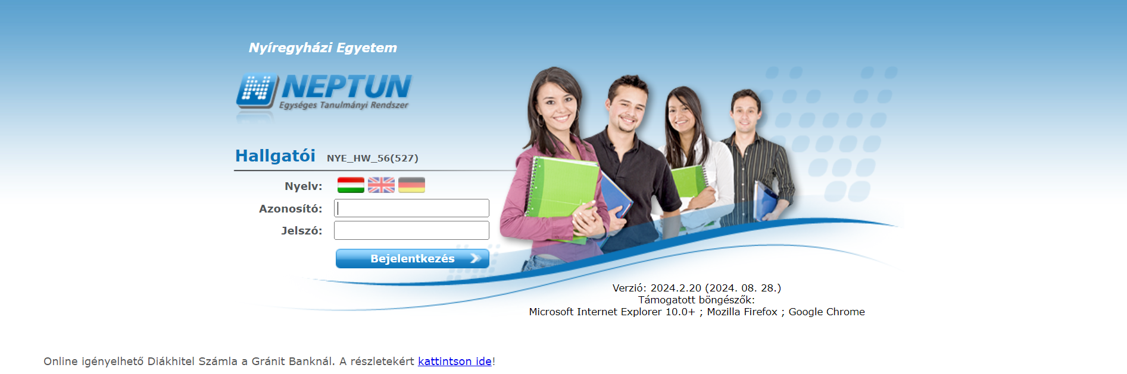
Your login name is your Neptun code, and the password for the first time is the word ’Ne’ and your birth date (YYYYMMDD). You will need to change the password after you logged in.

Slide 6
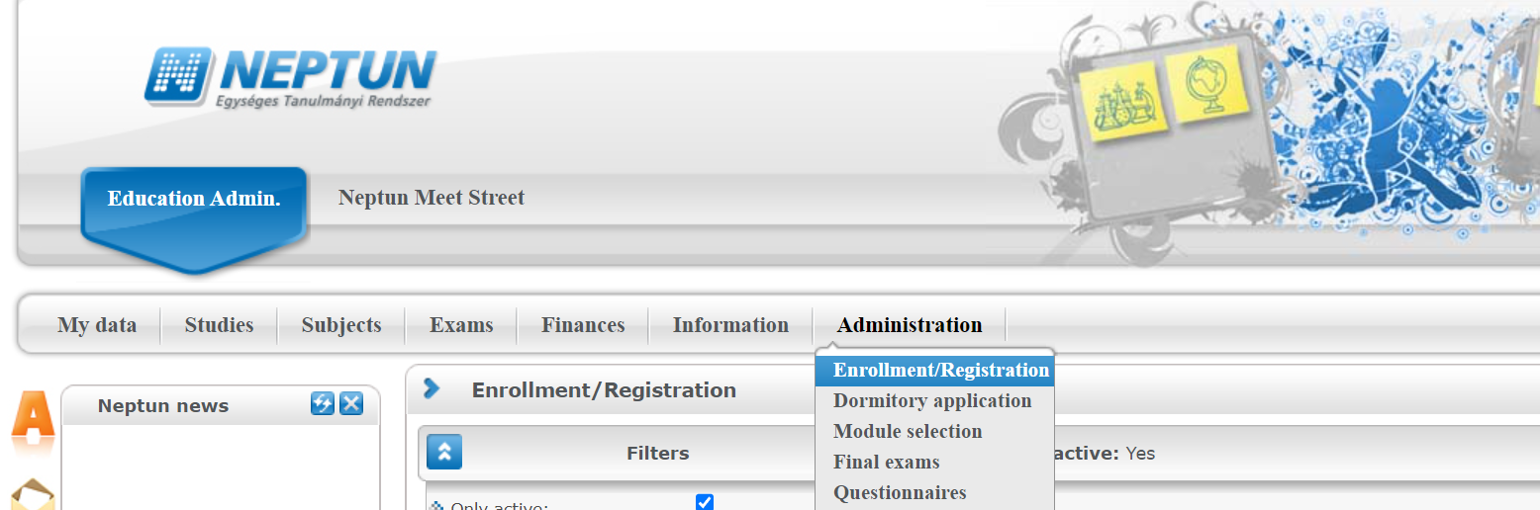
Registration – every semester!

Slide 7

Download the sample curriculum related to your studies!
https://ttajekoztato.nye.hu/

Slide 8
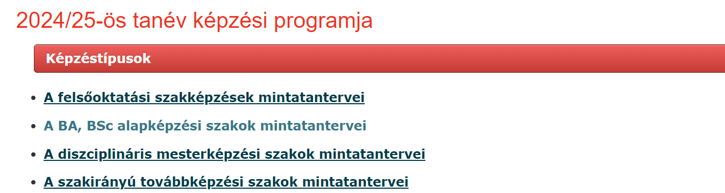
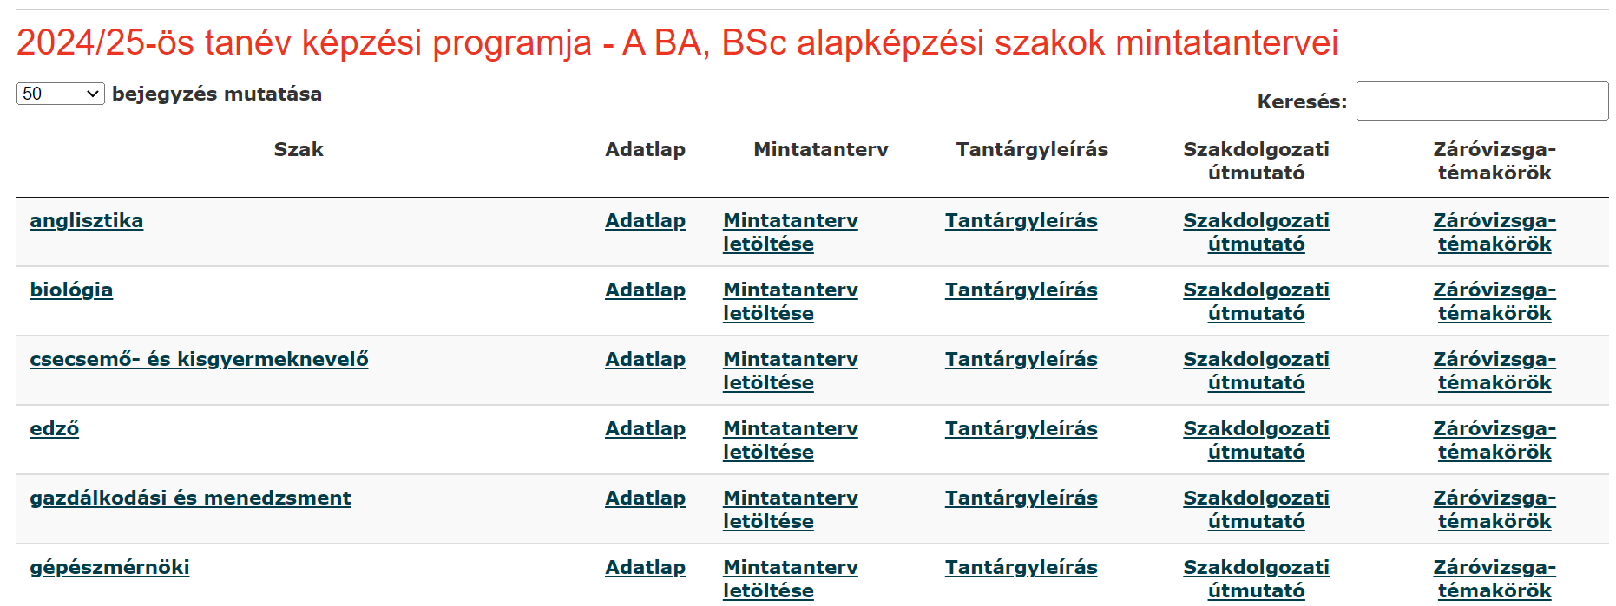

Slide 9
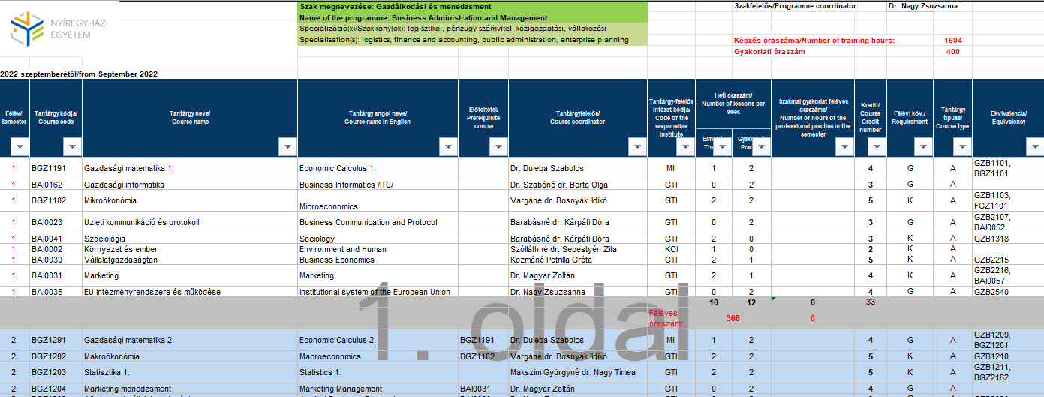
an optional course according to the institutional offer – „C” type courses

Slide 10
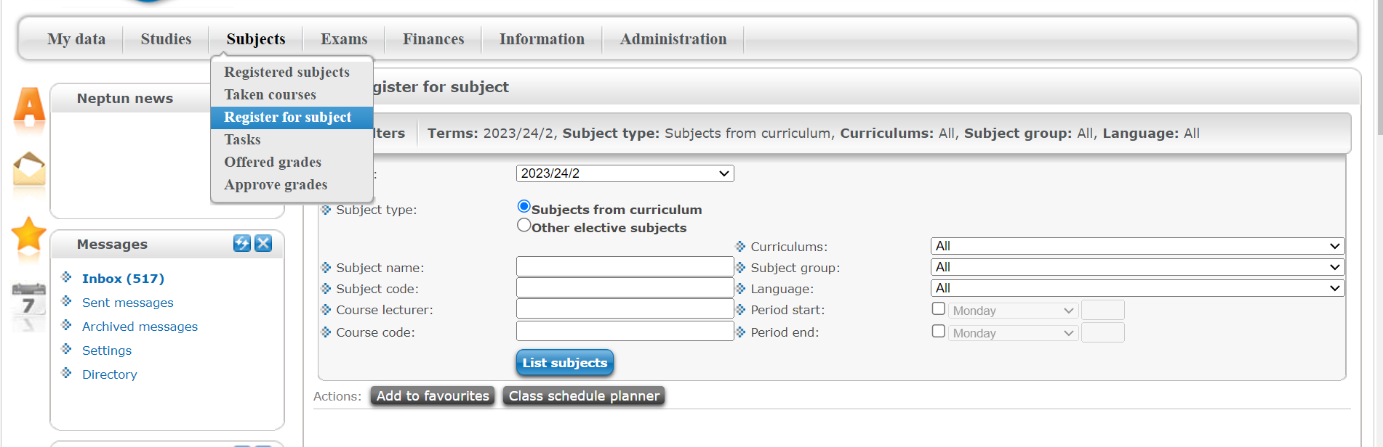
Register for subjects

Slide 11
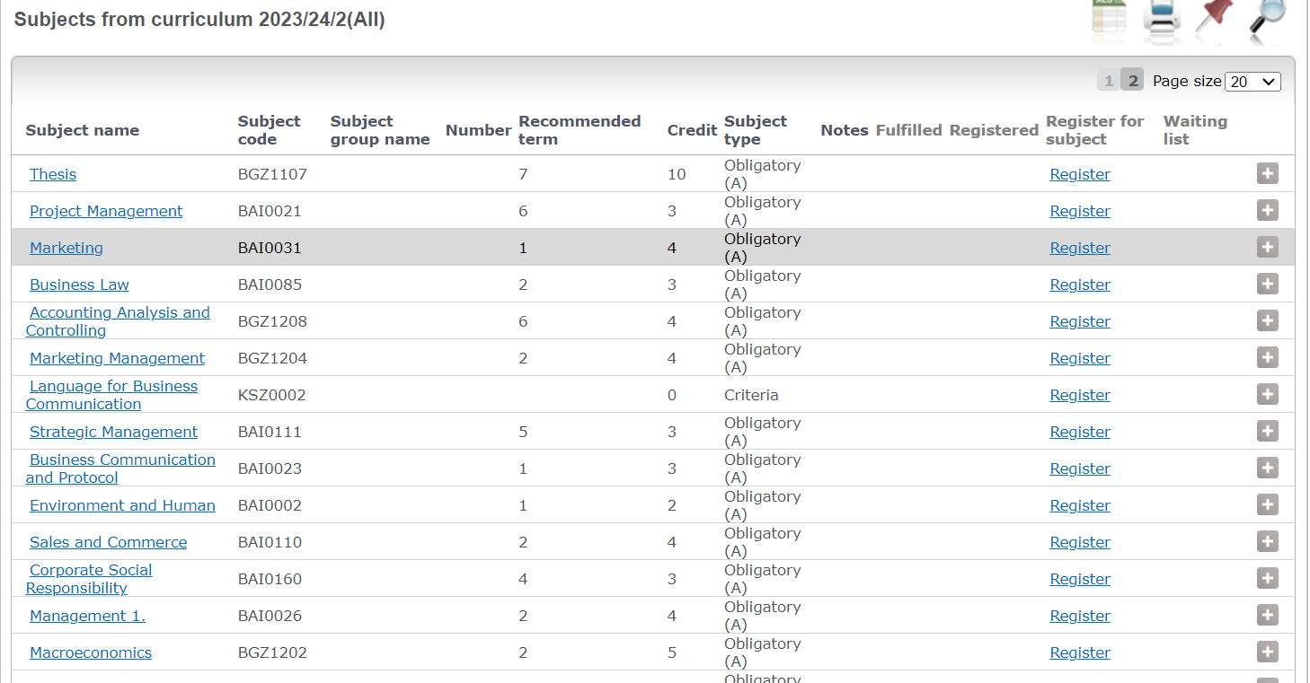

Slide 12
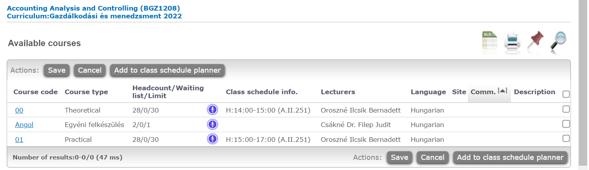
Add to class schedule planner ≠ Registration
Theory AND Practice
Course code: Angol OR A01, A02…

Slide 13
Drop subject
If you click the link “Options/Drop subject” in the row of any subject, the system prompts you whether you really want to drop the given subject; if your answer is yes, the subject will be deregistered and removedfrom the list of registered subjects. To access the same feature another way, left click to any subject detail, and then click to “Drop subject” on the “Available courses” tab in the “Subject data” popup window.
Naturally, by subject dropping your course registrations will be also removed, and you will receive a notification of this.
ATTENTION! Subject dropping is allowed only in the preliminary or final subject registration or course registration period!

Slide 14

https://tfo.nye.hu/hu/node/20 →
Neptun User Guide for students (NEW!)

Slide 15

Thank you for your attention!

